Slide 1
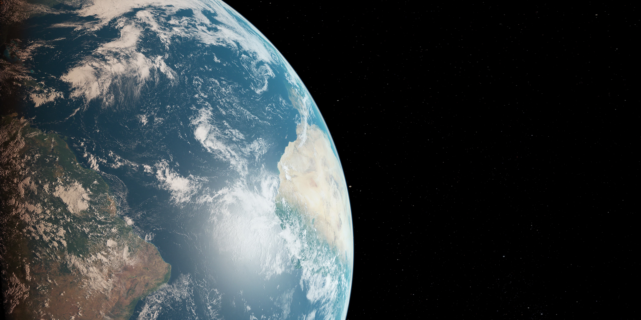

STAT41130: AI for Weather and Climate
Andrew Parnell

Slide 2
Course Introduction
Quick round table
Tools for this course:
AI by Hand by Tom Yeh: www.byhand.ai
Artificial Intelligence Forecasting System (AIFS),
Anemoi: https://github.com/ecmwf/anemoi-core
This is a hands-on course, mixing manual calculation and coding
Weather and climate are motivating applications, but the topics are generally useful

Slide 3
Github repo
All information at: https://github.com/andrewcparnell/STAT41130
Contains slides (PPT files), code (.py and .ipynb), but not the AI-by-hand worksheets (see web for these)
To access the material either:
Use git directly to download the materials
Go to the website and click: Code -> Download Zip
If you find typos/bugs either:
Let me know (basic)
File an issue on the GitHub page (intermediate)
Create a Pull Request and fix it yourself (advanced, and most helpful)

Slide 4
About this course
Learn to build and evaluate ML models for weather forecasting for use in your research
01
Understand what the models are doing in the background so that you can extend them
02
Work with real meteorological datasets and simulations
03

Slide 5
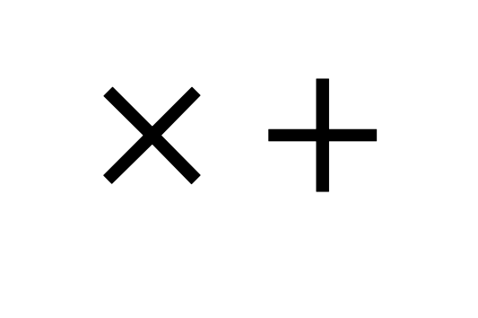
Who is this course for?
Designed for students with either AI or weather/climate background
No deep prior experience in both areas needed
Collaboration across disciplines is strongly encouraged
Lots of interaction and group work
Need you to download and install PollEverywhere on your phone: https://www.polleverywhere.com/
Main expert tools you need are:
$$× +$$

Slide 6
Structure of course
8 days:
2 1-hour lectures in the morning
1 1-hour guided coding class
2-3 hour self-guided coding exercise sheets in the afternoon
Computing labs use pytorch, AIFS and Anemoi
Lectures start from assuming no knowledge about NNs
Expect short quizzes, coding tasks, and pen-and-paper exercises
First quiz…

Slide 7

Notes:
Do not modify the notes in this section to avoid tampering with the Poll Everywhere activity. More info at polleverywhere.com/support In one or two words how would you describe your expertise? (e.g. Data Scientist, Meteorologist, Climate scientist, etc)
https://www.polleverywhere.com/free_text_polls/nsj1L6mLgbYEZsIFCTItp

Slide 8
Lecture 1: Neural Network Basics

Slide 9
Learning outcomes
Understand what neural networks are and how they create predictions
Build a small neural network step by step
Practice dot products, linear transforms, and activations by hand
Prepare for coding NNs this afternoon

Slide 10
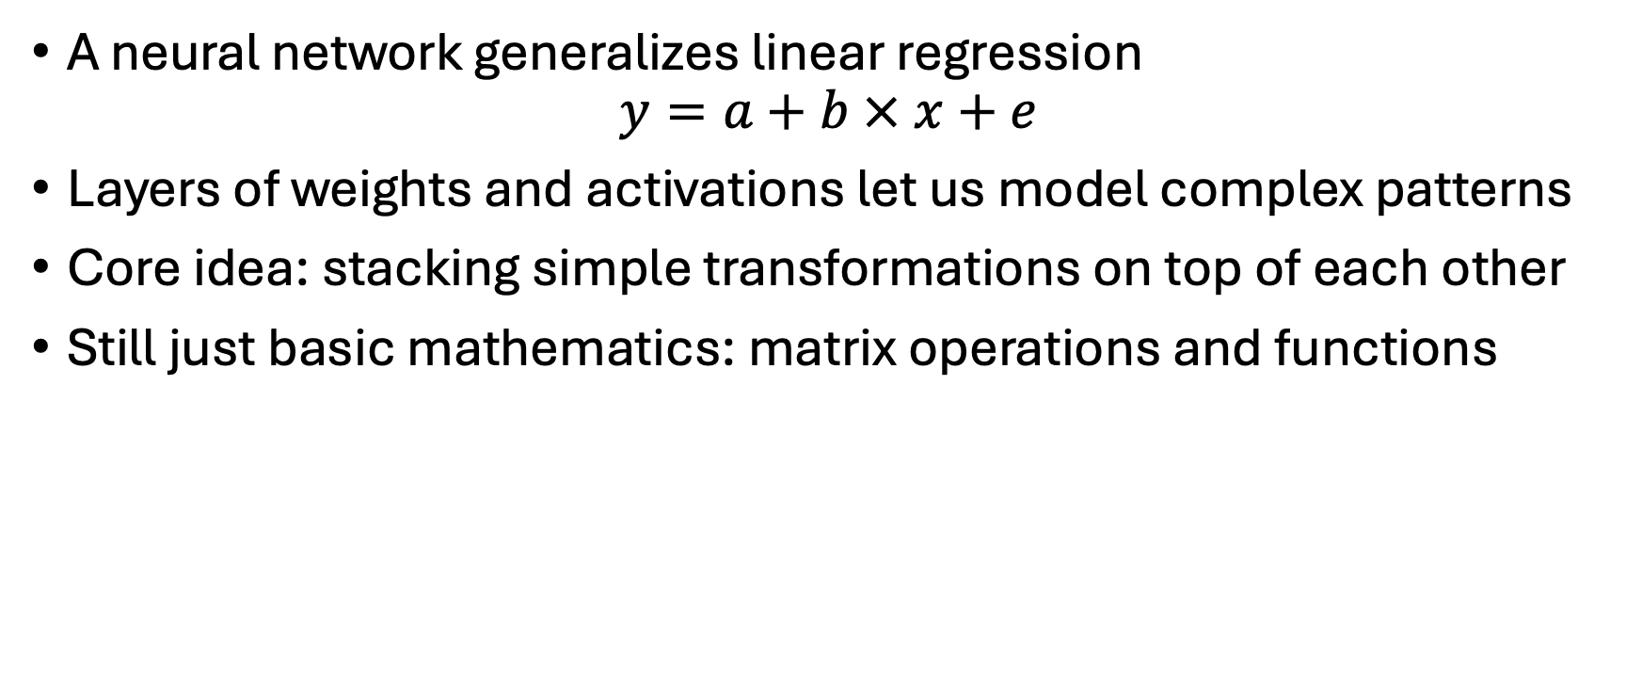
Foundations of Neural Networks (NNs)
A neural network generalizes linear regression
$$y=a+b × x+e$$
Layers of weights and activations let us model complex patterns
Core idea: stacking simple transformations on top of each other
Still just basic mathematics: matrix operations and functions

Slide 11
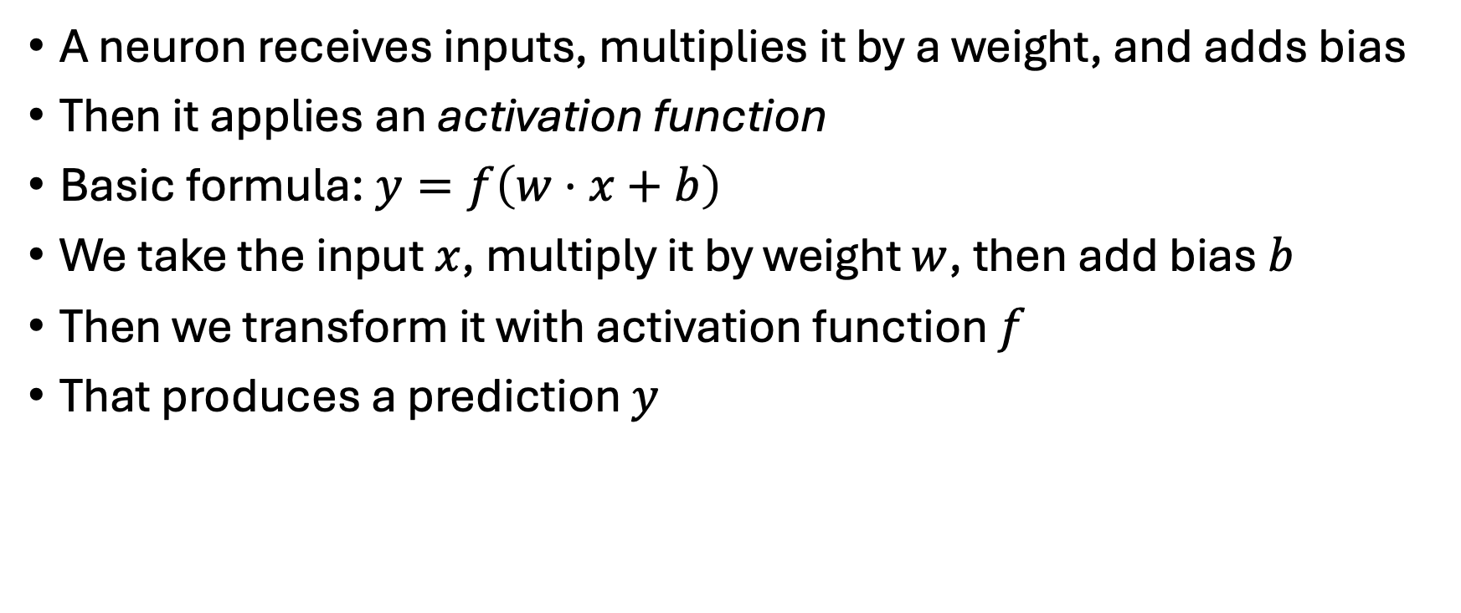
Neurons
A neuron receives inputs, multiplies it by a weight, and adds bias
Then it applies an activation function
Basic formula:$y=f\left(w⋅x+b\right)$
We take the input $x$, multiply it by weight $w$, then add bias $b$
Then we transform it with activation function $f$
That produces a prediction $y$

Slide 12
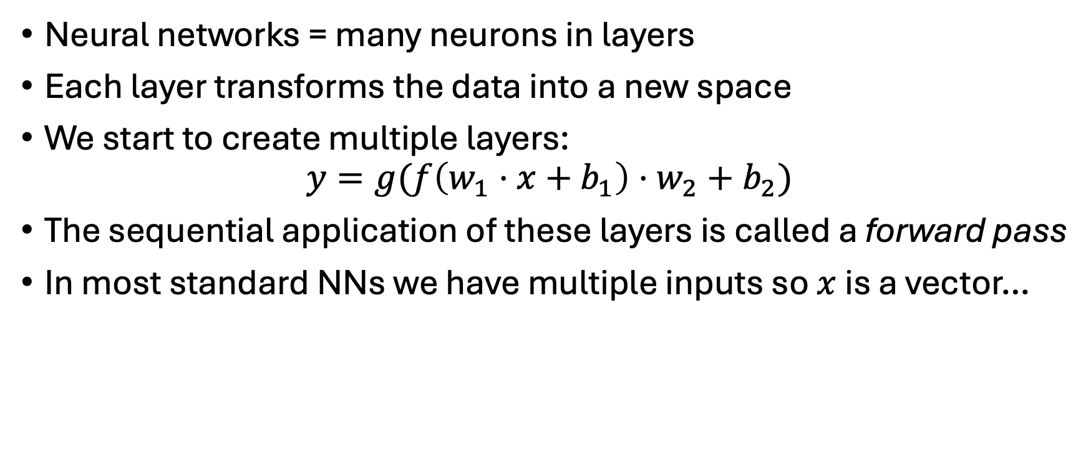
Networks as compositions
Neural networks = many neurons in layers
Each layer transforms the data into a new space
We start to create multiple layers:
$$y=g(f\left(w_{1}⋅x+b_{1}\right)⋅w_{2}+b_{2})$$
The sequential application of these layers is called a forward pass
In most standard NNs we have multiple inputs so $x$ is a vector…

Slide 13
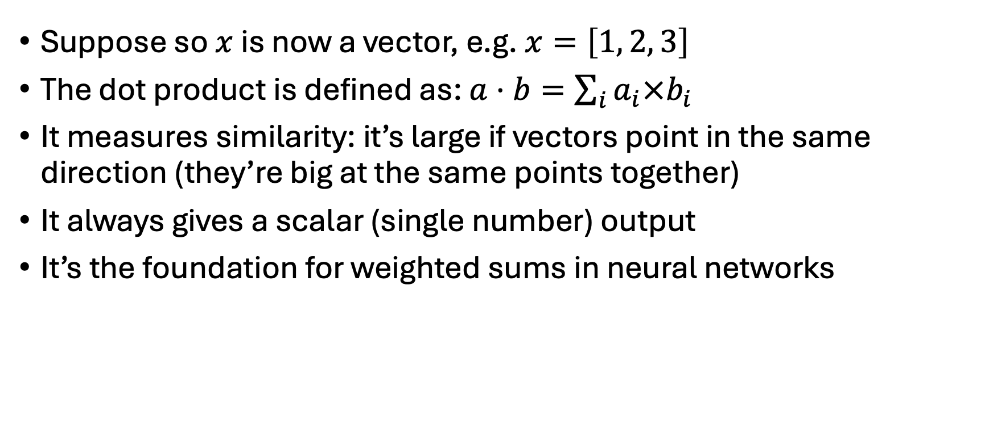
Dot Products
Suppose so $x$ is now a vector, e.g. $x=\left[1, 2, 3\right]$
The dot product is defined as: $a⋅b=\sum_{i}{a_{i}×b_{i}}$
It measures similarity: it’s large if vectors point in the same direction (they’re big at the same points together)
It always gives a scalar (single number) output
It’s the foundation for weighted sums in neural networks

Slide 14
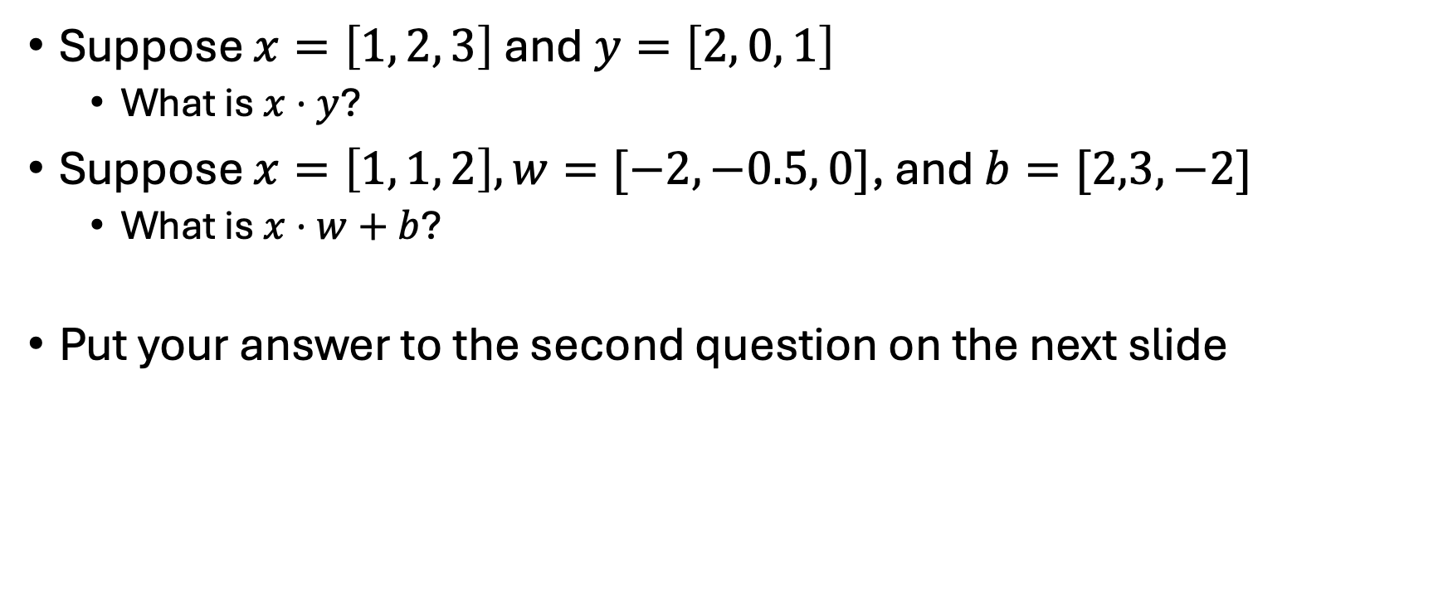
Dot product quiz
Suppose $x=\left[1, 2, 3\right]$ and$y=\left[2, 0, 1\right]$
What is $x⋅y$?
Suppose $x=\left[1, 1, 2\right], w=[−2, −0.5, 0]$, and $b=[2,3,−2]$
What is $x⋅w+b$?
Put your answer to the second question on the next slide

Slide 15
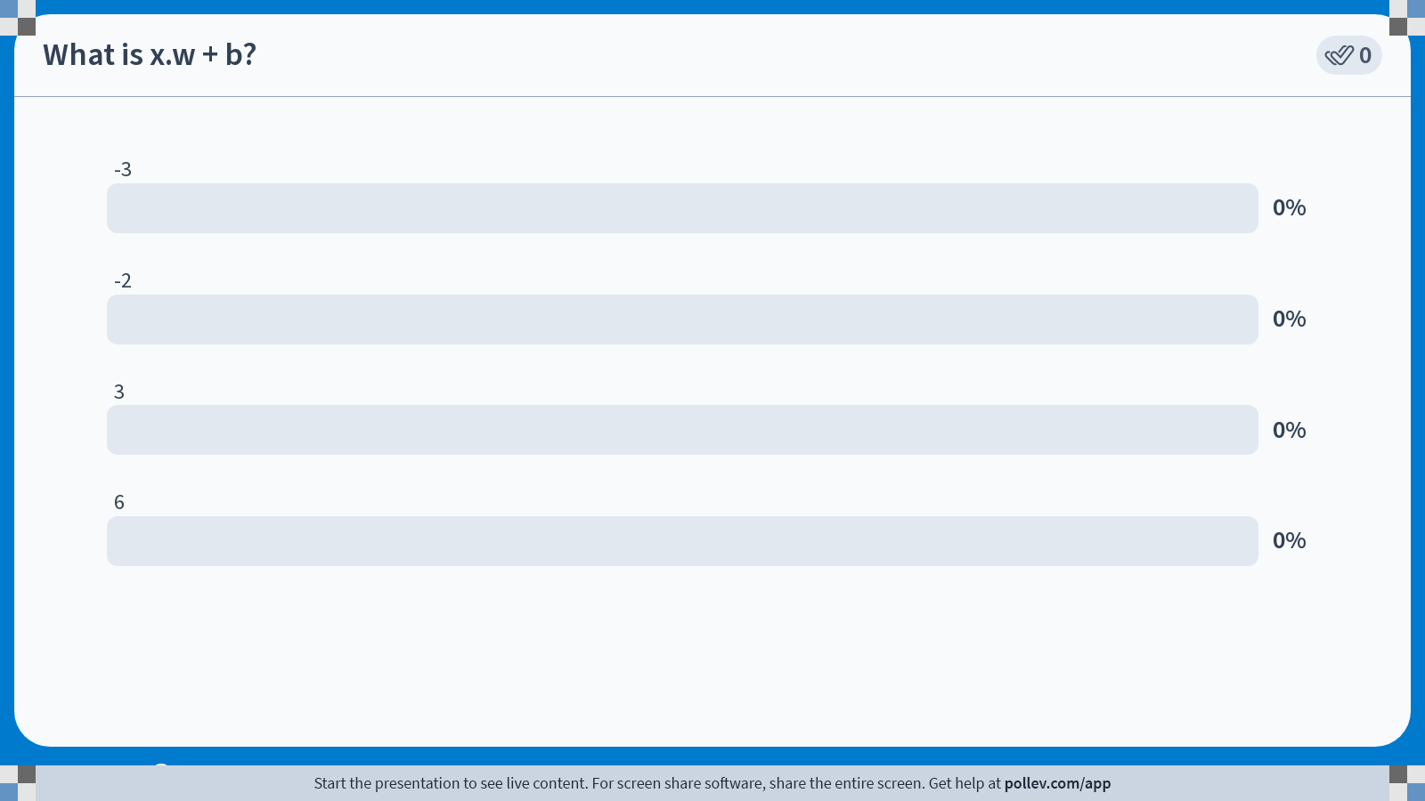
Notes:
Do not modify the notes in this section to avoid tampering with the Poll Everywhere activity. More info at polleverywhere.com/support What is x.w + b?
https://www.polleverywhere.com/multiple_choice_polls/4tZfddIIaHdmsw4Tl8Mqu?state=opened&flow=Default&onscreen=persist

Slide 16
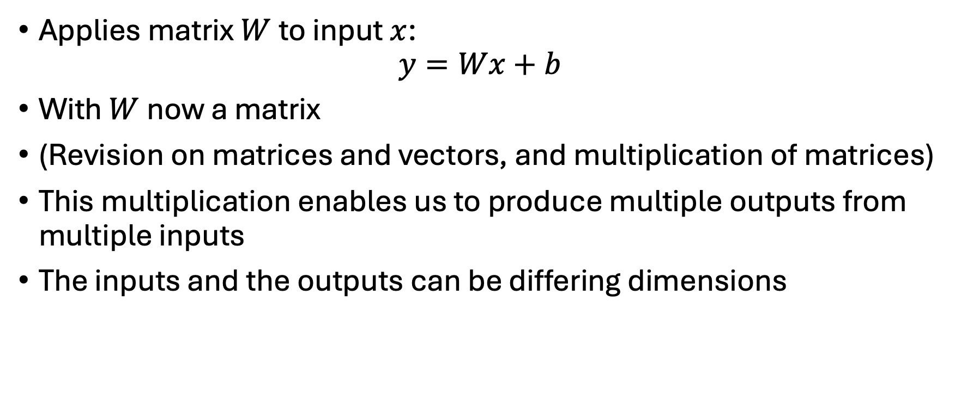
Linear Layers
Applies matrix $W$ to input $x$:
$$y=Wx+b$$
With $W$ now a matrix
(Revision on matrices and vectors, and multiplication of matrices)
This multiplication enables us to produce multiple outputs from multiple inputs
The inputs and the outputs can be differing dimensions

Slide 17
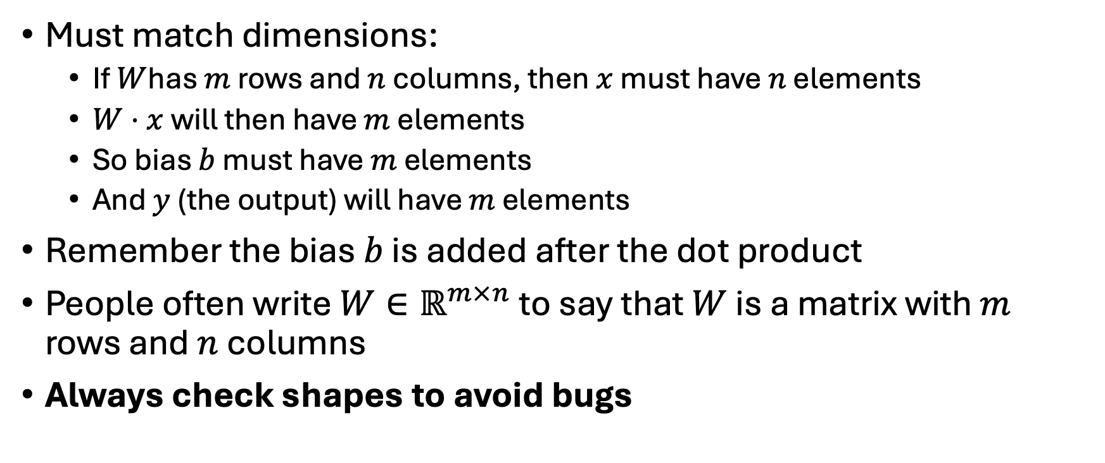
Matrix Shapes and Rules
Must match dimensions:
If $W$has $m$ rows and $n$ columns, then $x$ must have $n$ elements
$W⋅x$ will then have $m$ elements
So bias $b$ must have $m$ elements
And $y$ (the output) will have $m$ elements
Remember the bias $b$ is added after the dot product
People often write $W∈ℝ^{m×n}$ to say that $W$ is a matrix with $m$ rows and $n$ columns
Always check shapes to avoid bugs

Slide 18
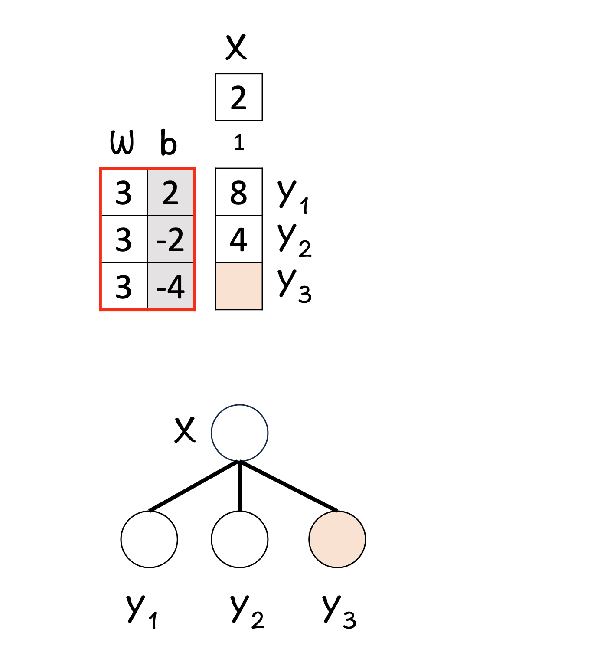
Hands-On: Linear Layer Example
Walk through one full forward pass manually
Remember element-wise steps: multiply → sum up → add bias
Check shape before and after to see if it makes sense

Slide 19
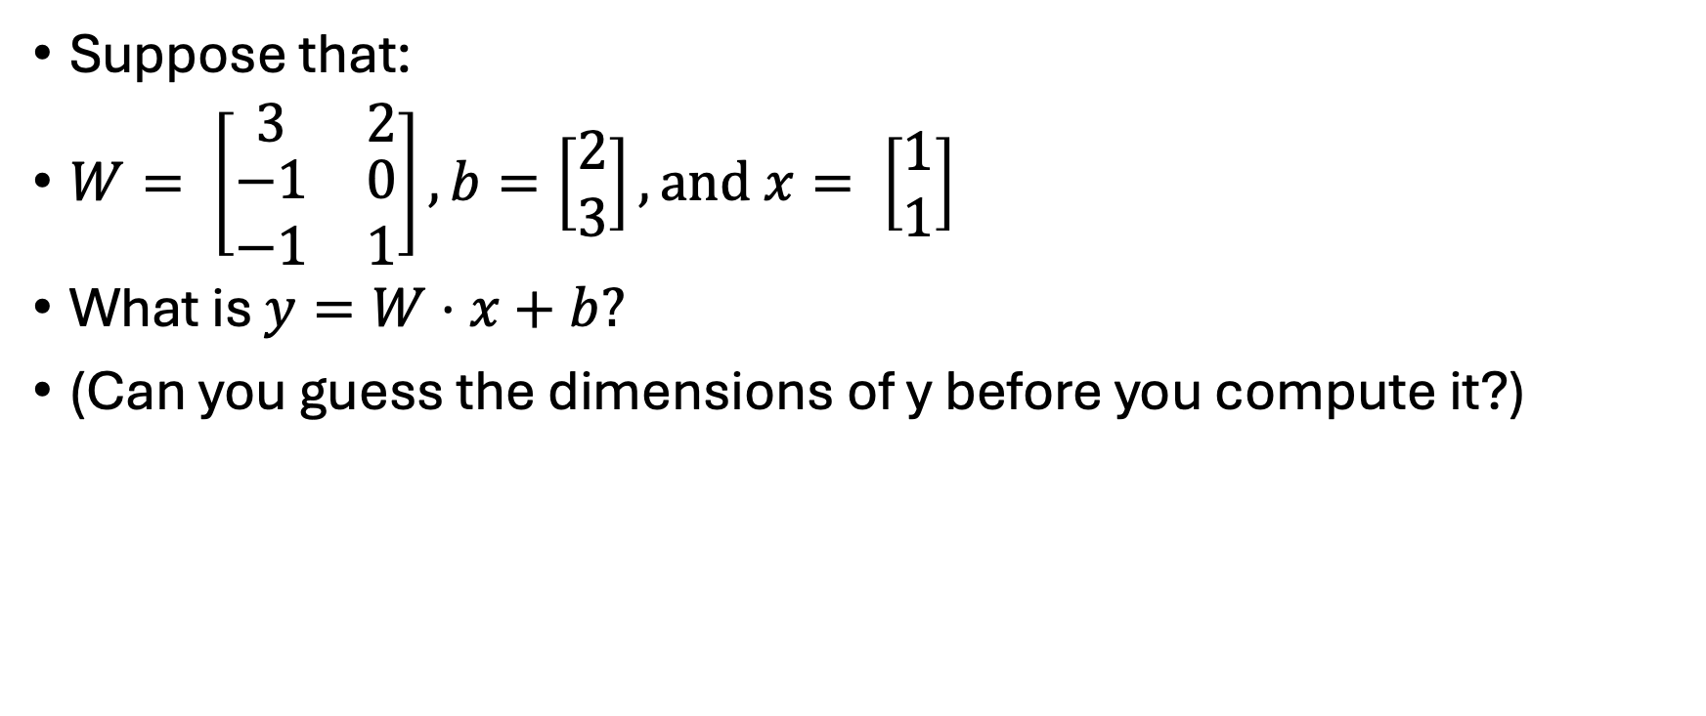
Can you do these?
Suppose that:
$W= \left[\begin{matrix}3 & 2 \\ \begin{aligned}−1 \\ −1\end{aligned} & \begin{aligned}0 \\ 1\end{aligned}\end{matrix}\right], b=\left[\begin{matrix}2 \\ 3\end{matrix}\right], and x= \left[\begin{matrix}1 \\ 1\end{matrix}\right]$
What is $y=W⋅x+b?$
(Can you guess the dimensions of y before you compute it?)

Slide 20
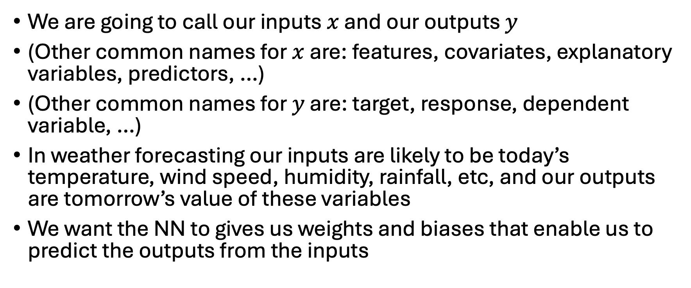
How does this link to weather and climate
We are going to call our inputs $x$ and our outputs $y$
(Other common names for $x$ are: features, covariates, explanatory variables, predictors, …)
(Other common names for $y$ are: target, response, dependent variable, …)
In weather forecasting our inputs are likely to be today’s temperature, wind speed, humidity, rainfall, etc, and our outputs are tomorrow’s value of these variables
We want the NN to gives us weights and biases that enable us to predict the outputs from the inputs

Slide 21
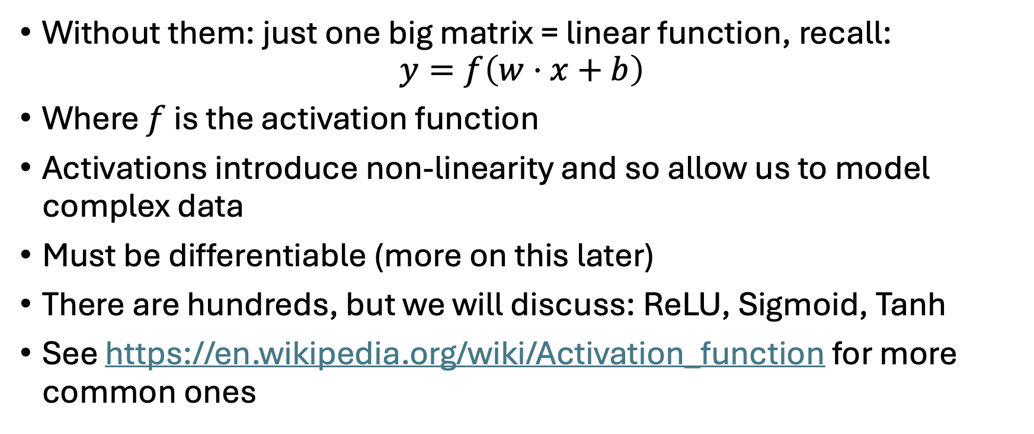
Activation functions
Without them: just one big matrix = linear function, recall:
$$y=f\left(w⋅x+b\right)$$
Where $f$ is the activation function
Activations introduce non-linearity and so allow us to model complex data
Must be differentiable (more on this later)
There are hundreds, but we will discuss: ReLU, Sigmoid, Tanh
See https://en.wikipedia.org/wiki/Activation_function for more common ones

Slide 22
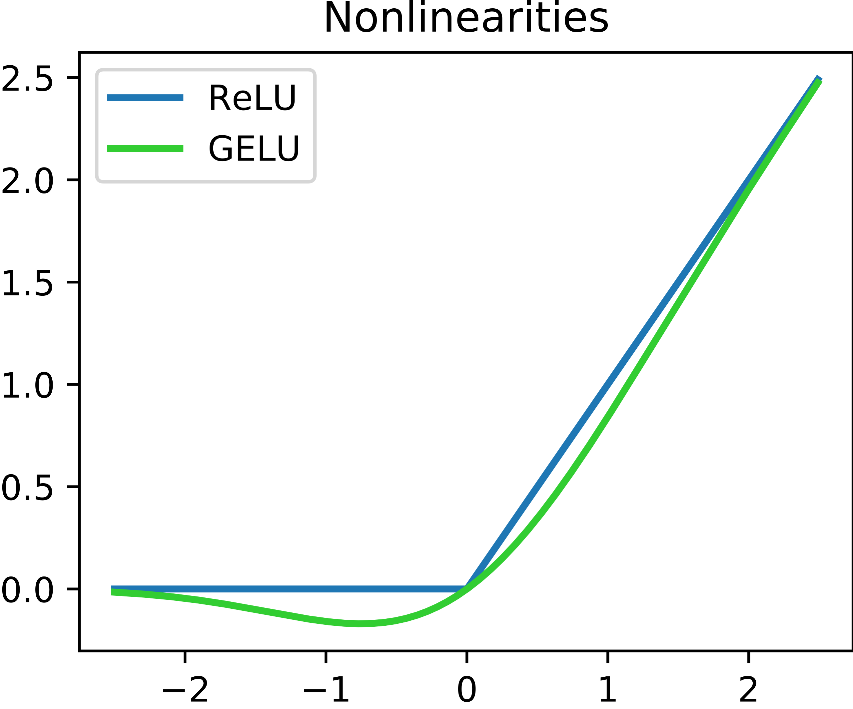
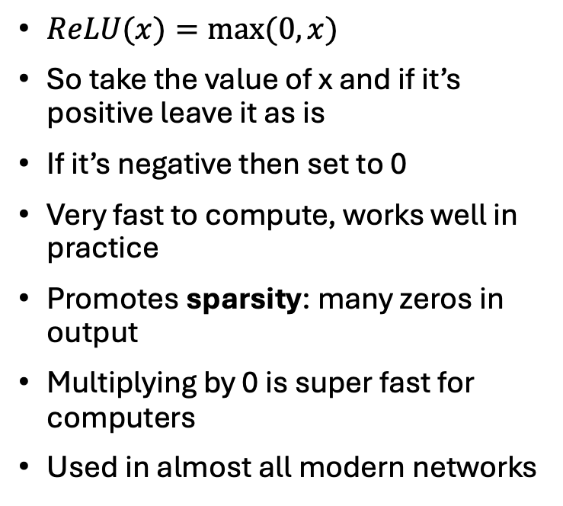
ReLU – Rectified Linear Unit
$ReLU(x)=max⁡(0,x)$
So take the value of x and if it’s positive leave it as is
If it’s negative then set to 0
Very fast to compute, works well in practice
Promotes sparsity: many zeros in output
Multiplying by 0 is super fast for computers
Used in almost all modern networks
From https://en.wikipedia.org/wiki/Rectifier_(neural_networks)

Slide 23
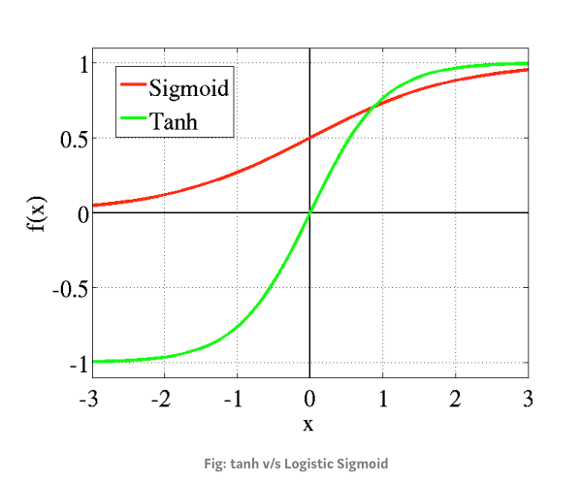
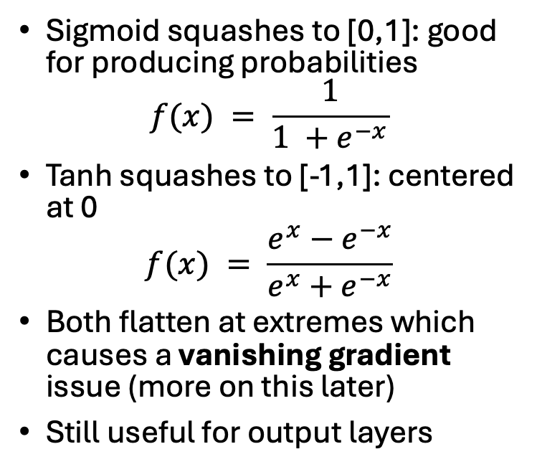
Sigmoid and tanh
Sigmoid squashes to [0,1]: good for producing probabilities
$$f(x) = \frac{1}{1 +e^{−x}}$$
Tanh squashes to [-1,1]: centered at 0
$$f(x) = \frac{e^{x}−e^{−x}}{e^{x}+e^{−x}}$$
Both flatten at extremes which causes a vanishing gradient issue (more on this later)
Still useful for output layers
From https://miro.medium.com/v2/resize:fit:1280/1*R2e5_A-hD3VB3B1wv3qaQA.png

Slide 24
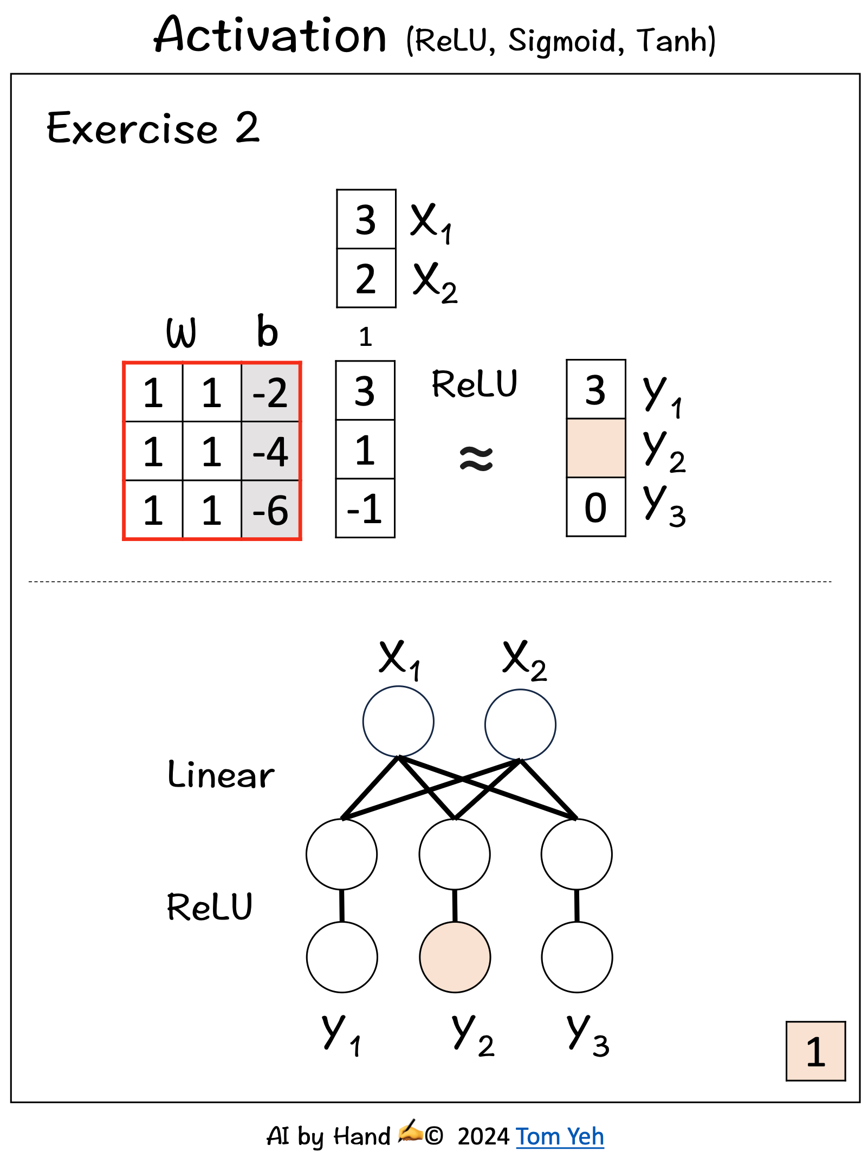
Activation Practice
See the example opposite
Same process, one extra step: input, weight, bias → compute pre-activation → apply function
Could also apply sigmoid or tanh activation functions
What differences do you observe?

Slide 25
Building a simple network
Input: 2-d vector x
Linear transform: W, b
ReLU activation
Output: 2-d hidden representation

Slide 26
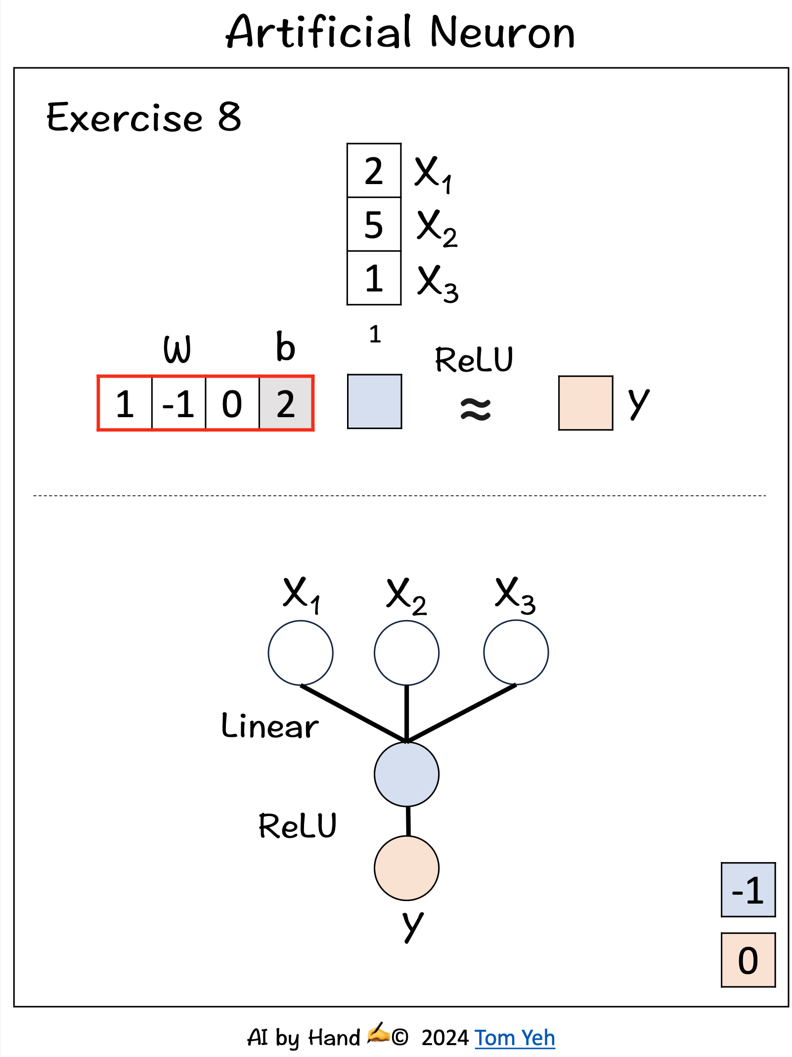
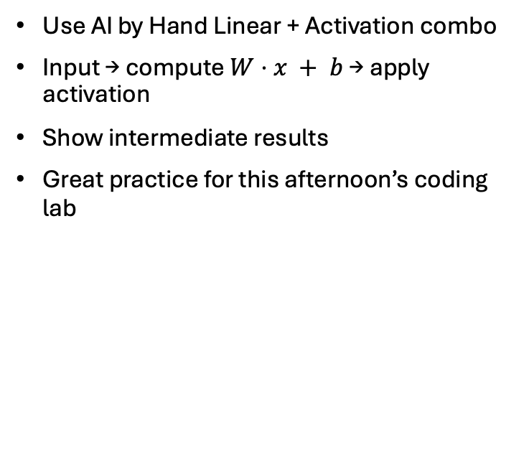
Manual forward pass
Use AI by Hand Linear + Activation combo
Input → compute $W⋅x + b$→ apply activation
Show intermediate results
Great practice for this afternoon’s coding lab

Slide 27
Quiz Time – Check Your Understanding
What happens if bias is zero?
What are the implications of not using an activation function?
How many weights in a 2-layer net with 3 neurons each?

Slide 28
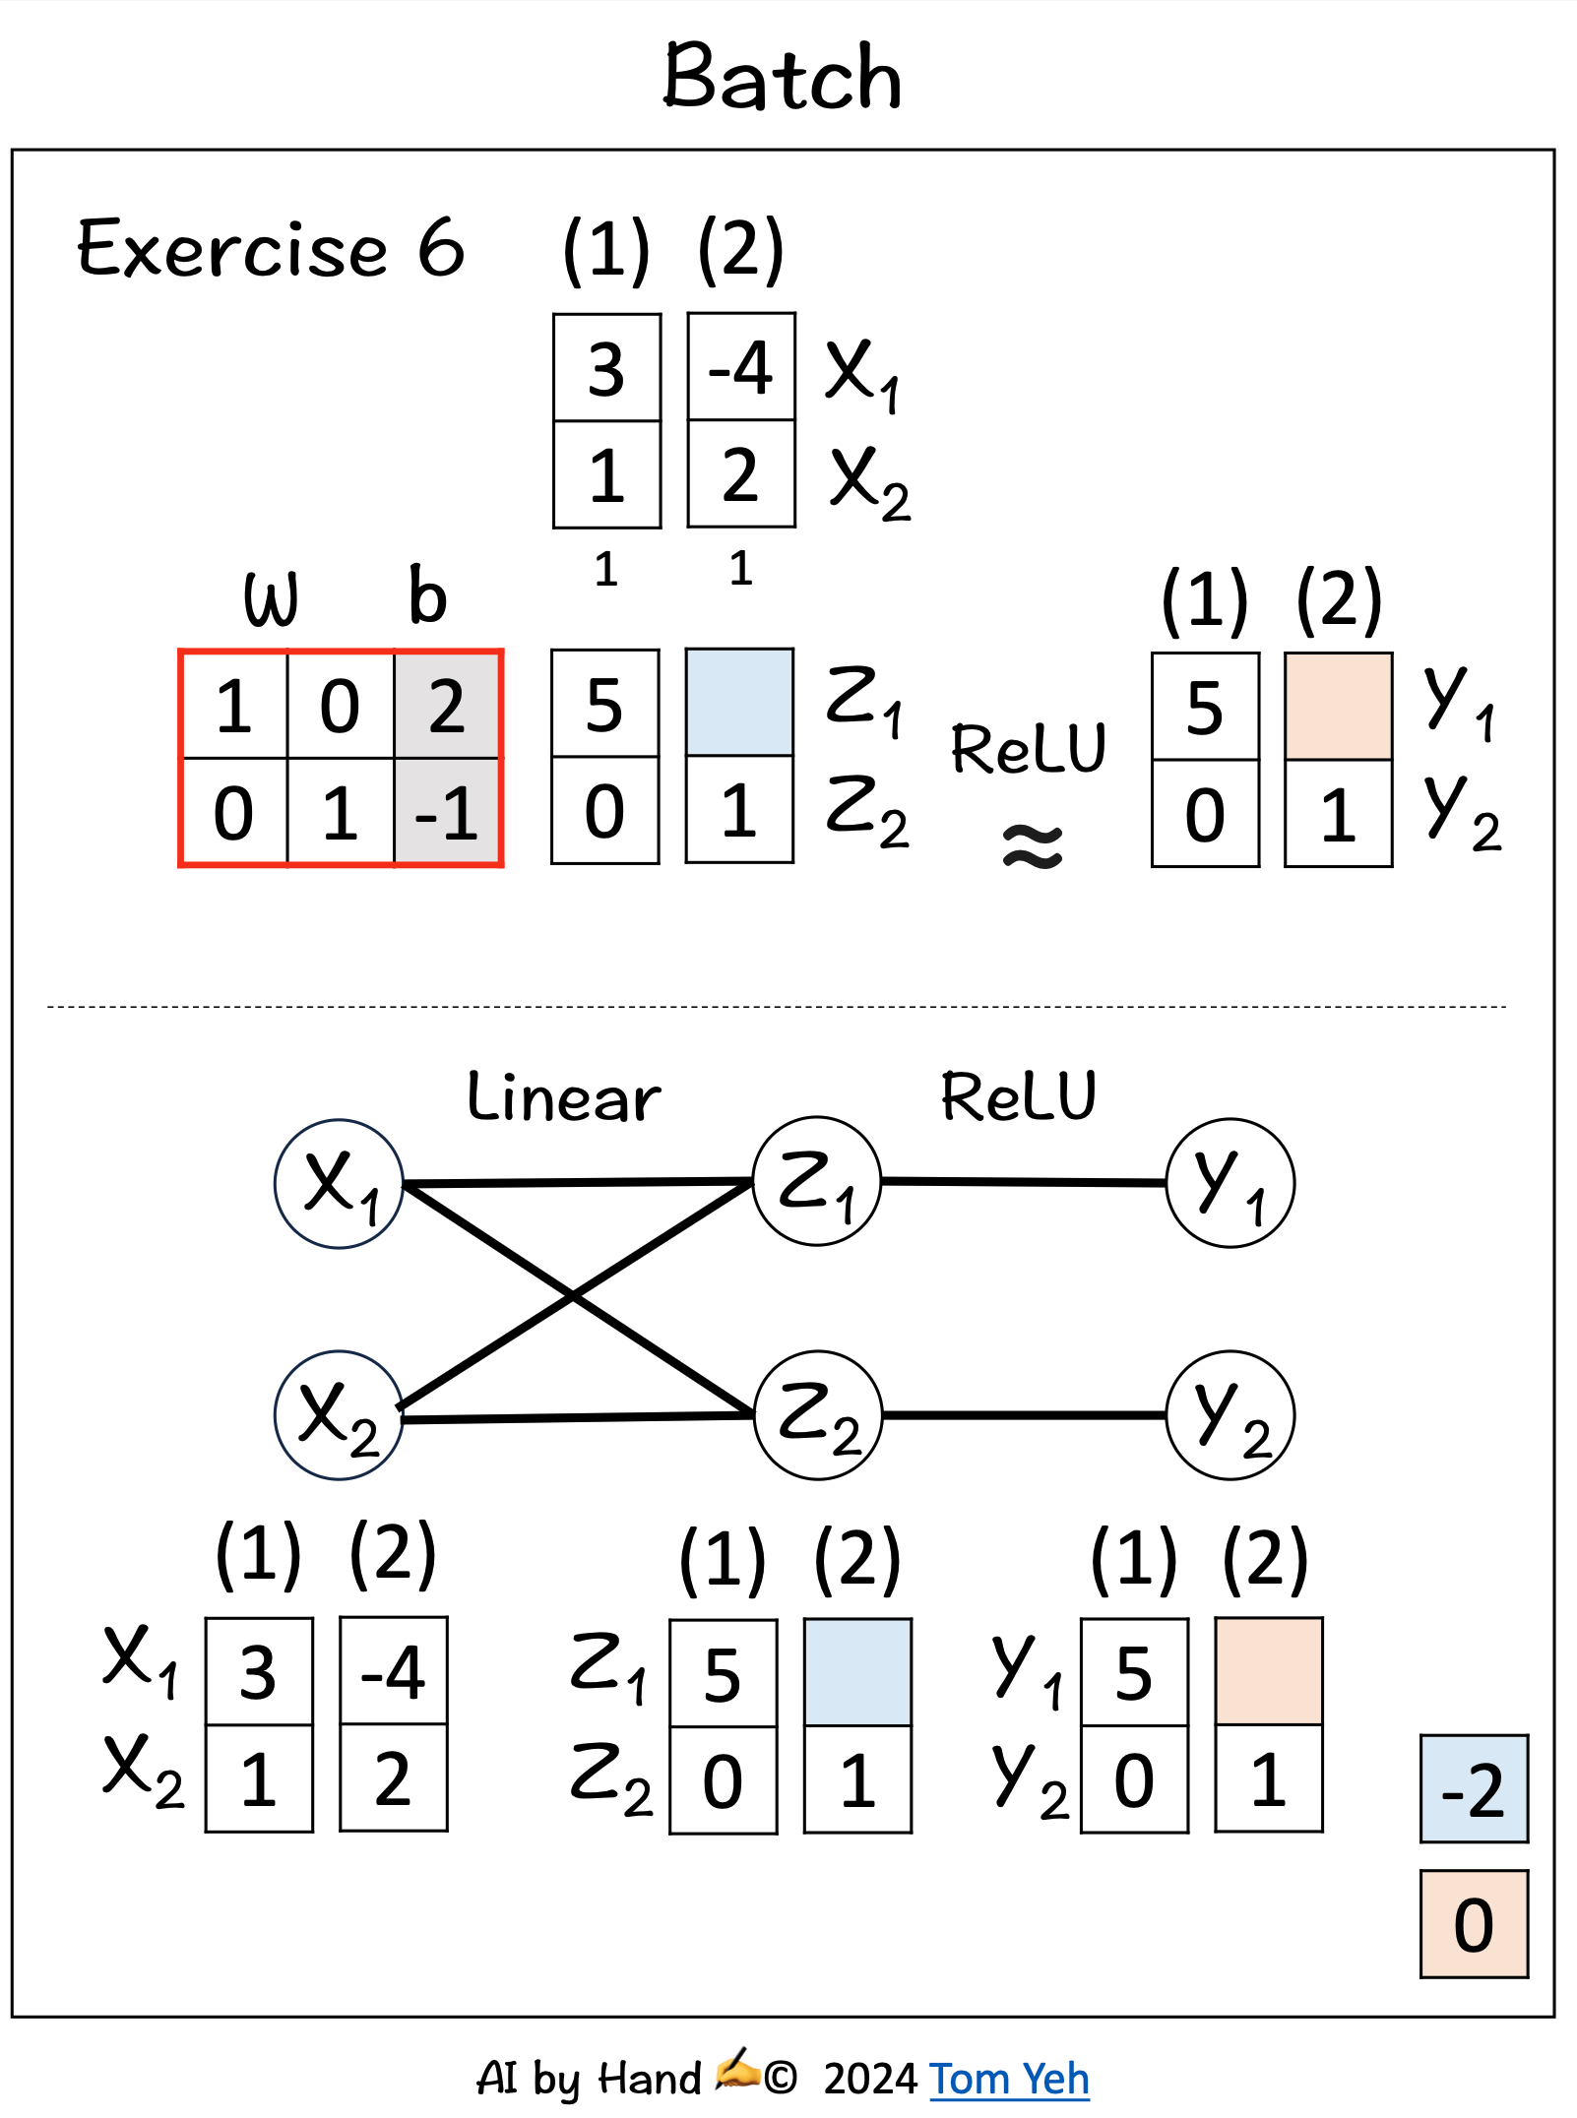
Multi-layered network architecture
In real-world NNs there are many neurons at different layers of the architecture. Each has its own weights and biases
Here Z is a hidden layer with two neurons, each of which has its own weights and biases

Slide 29
A neural network for weather data
Inputs = today’s temperature, humidity, wind speed...
Outputs = tomorrow’s temperature, humidity, wind speed
NNs can learn the spatial and temporal patterns
Next lecture: discover how NNs learn the weights and the biases from data

Slide 30
Common pitfalls
Forgetting bias
Confusing dimensions
Applying wrong (or inappropriate) activation function
Check, check, and check again (and use LLMs)

Slide 31
Group challenge
Team Challenge – Compute Output
Give a small network: 2 inputs, 2 neurons, ReLU
Groups of 2 solve on paper
Compare answers: any mistakes?
What did ReLU “zero out”?
Figure: Pre-filled input and weights, blanks for output.

Slide 32
Next class: training
So far: forward pass only. i.e. taking weights and biases, and getting to the outputs
Next: how do we learn weights?
Concepts of loss, gradients, updates

Slide 33
Summary
Dot product → linear layer → activation → output
Also quite a lot of matrix by hand
You did this by hand – this afternoon doing it all in code

